Slide 1
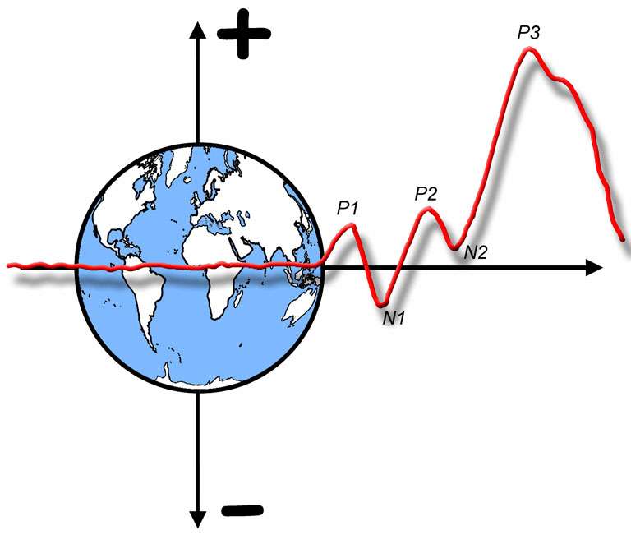

The ERP Boot Camp
Artifact Correction

Slide 2
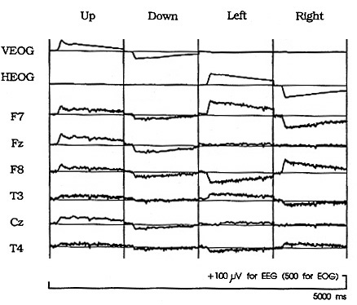
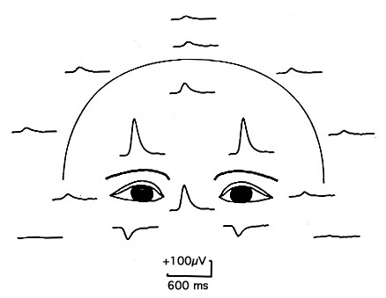
Artifact Correction
Most artifact correction procedures take advantage of the fact that most artifacts have a consistent scalp distribution
Pz
Cz
C3
Fz
C4
T3
T4
Lm
Rm
Lins, Picton, Berg, & Scherg (1993)
Notes:
Figure 3 and Figure 4 Lins, Picton, Berg, Scherg (1993) Ocular artifacts in recording EEGs and event-related potentials. I: Scalp Topography. Brain Topography 6,1. 51-63. Reprinted with permission from Springer. © Springer. This material may be used for nonprofit research and education purposes only, and it may not be reprinted or distributed in any form including print and electronic forms.

Slide 3
Artifact Correction
Goal: Estimate contribution of artifact at each EEG channel and subtract it
Fairly easy to compute propagation factors
Problem: Signal at EOG electrodes contains non-artifact activity as well as artifact activity
The first technique (Gratton et al., 1983) “overcorrects” and distorts the scalp distribution of the ERP components
The best approaches use more sophisticated ways of estimating the actual ocular activity
Dipole source localization
Independent component analysis
Notes:
© S. J. Luck. All Rights Reserved. May be used for nonprofit educational purposes if this copyright notice is included. Permission must be obtained from the copyright holder(s) for any other use.

Slide 4
Artifact Correction with ICA
In most (but not all) cases, artifacts will have a fixed scalp distribution and will be statistically independent of ERPs
Examples: Blinks, line noise
ICA uses the pattern of covariation of data across time points to derive the time course and scalp distribution of each component
Details will be provided in a minute
To remove artifact, data are reconstructed by simply adding together the non-artifact components
Notes:
© S. J. Luck. All Rights Reserved. May be used for nonprofit educational purposes if this copyright notice is included. Permission must be obtained from the copyright holder(s) for any other use.

Slide 5
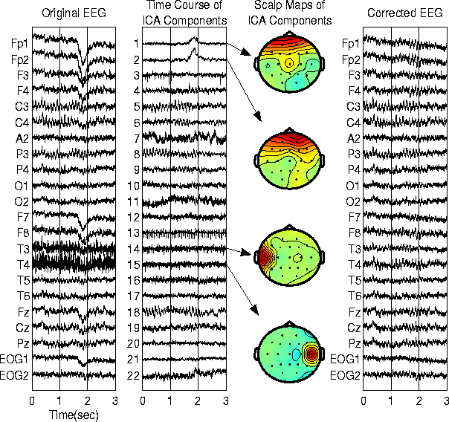
http://www.sccn.ucsd.edu/~scott/tutorial/icatutorial8.html
Notes:
http://www.sccn.ucsd.edu/~scott/tutorial/icatutorial8.html
Other content: © S. J. Luck. All Rights Reserved. May be used for nonprofit educational purposes if this copyright notice is included. Permission must be obtained from the copyright holder(s) for any other use.

Slide 6
General Logic
Time course of each component
Waveform at each electrode site
C1
C2
C3
w_{1,1}
E1
w_{2,1}
w_{3,1}
w_{1,2}
w_{2,2}
E2
w_{3,2}
w_{1,3}
w_{2,3}
E3
w_{3,3}
Normal
Notes:
© S. J. Luck. All Rights Reserved. May be used for nonprofit educational purposes if this copyright notice is included. Permission must be obtained from the copyright holder(s) for any other use.

Slide 7
General Logic
Time course of each component
Waveform at each electrode site
C1
C2
C3
w_{1,1}
E1
w_{2,1}
w_{3,1}
w_{1,2}
w_{2,2}
E2
w_{3,2}
w_{1,3}
w_{2,3}
E3
w_{3,3}
Normal
After zeroing C2
Notes:
© S. J. Luck. All Rights Reserved. May be used for nonprofit educational purposes if this copyright notice is included. Permission must be obtained from the copyright holder(s) for any other use.

Slide 8
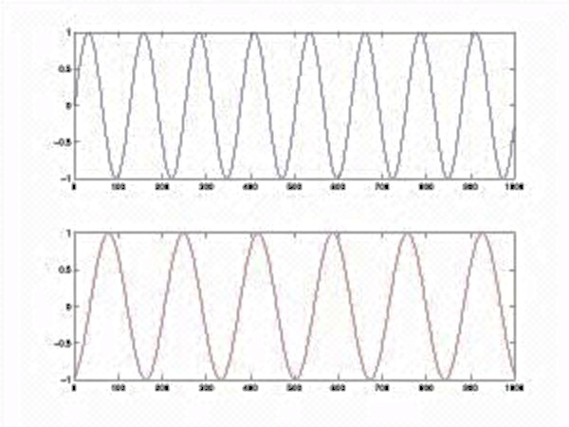
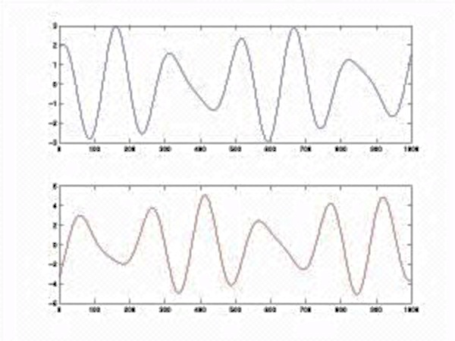
Mixing and Unmixing
Source A
Mixture 1 = A + -2B
Source B
Mixture 2 = 1.73A +3.41B
Goal of ICA- Figure out an “unmixing” matrix that will allow us to recover the time courses of the sources from the observed mixtures
Blind Source Separation- No assumptions about the sources except that (a) they are independent, and (b) # of sources = # of mixtures
Notes:
© S. J. Luck. All Rights Reserved. May be used for nonprofit educational purposes if this copyright notice is included. Permission must be obtained from the copyright holder(s) for any other use.

Slide 9
Mixing and Unmixing
Need to figure out mixing and unmixing matrices
C1
C2
C3
w_{1,1}
E1 =
1xC1 + .5xC2 + 1xC3
E2 =
.25xC1 + .5xC2 + .75xC3
E3 =
.5xC1 + -.5xC2 + .5xC3
w_{2,1}
w_{3,1}
w_{1,2}
w_{2,2}
w_{3,2}
w_{1,3}
w_{2,3}
w_{3,3}
w_{i,j} = weight from component i to Electrode j
w_{i} = scalp distribution of component i
 | Component 1 | Component 2 | Component 3
Electrode 1 | 1 | 0.5 | 1
Electrode 2 | 0.25 | 0.5 | 0.75
Electrode 3 | 0.5 | -0.5 | 0.5
Mixing
Matrix
Notes:
© S. J. Luck. All Rights Reserved. May be used for nonprofit educational purposes if this copyright notice is included. Permission must be obtained from the copyright holder(s) for any other use.

Slide 10
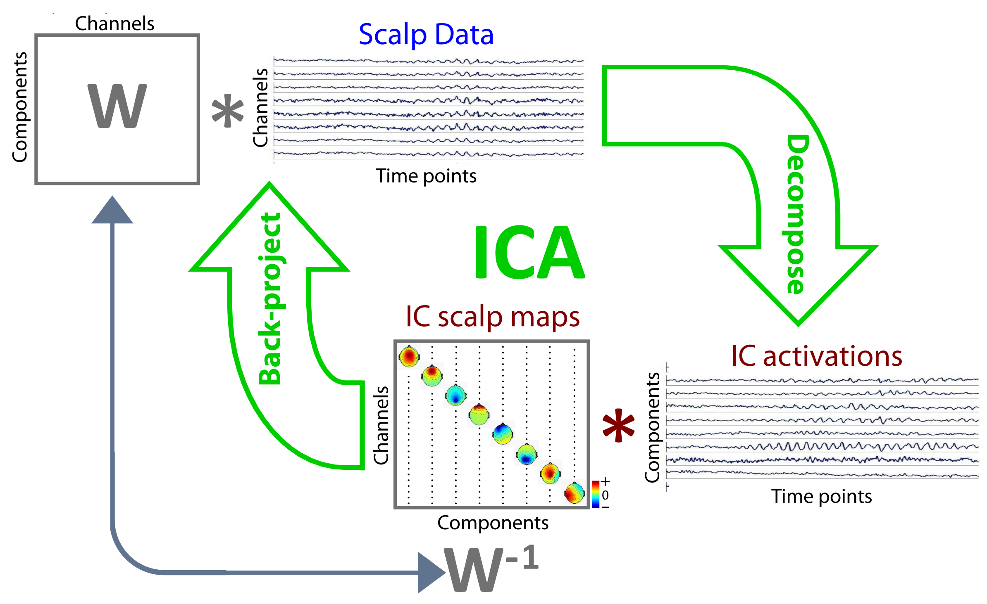
ICA Flow
Unmixing Matrix
Mixing Matrix
Notes:
© S. J. Luck. All Rights Reserved. May be used for nonprofit educational purposes if this copyright notice is included. Permission must be obtained from the copyright holder(s) for any other use.

Slide 11
Finding the Unmixing Matrix
ICA figures out the unmixing matrix by looking at statistical relationships among the EEG channels
ICA knows nothing about where the electrodes are located or even the order of time samples
A neural network “learns” the unmixing matrix from the statistical properties of the data
The components are defined by being maximally independent
Notes:
© S. J. Luck. All Rights Reserved. May be used for nonprofit educational purposes if this copyright notice is included. Permission must be obtained from the copyright holder(s) for any other use.

Slide 12
Meaning of “Independent”
Two components are independent if the value of one component at time t provides no information about the value of the other component at time t
Time course of IC1 in a 1-sec period of EEG
Time course of IC2 in a 1-sec period of EEG
Notes:
© S. J. Luck. All Rights Reserved. May be used for nonprofit educational purposes if this copyright notice is included. Permission must be obtained from the copyright holder(s) for any other use.

Slide 13
Meaning of “Independent”
Two components are independent if the value of one component at time t provides no information about the value of the other component at time t
Values of two components (IC1 and IC2) at different moments in time
Notes:
© S. J. Luck. All Rights Reserved. May be used for nonprofit educational purposes if this copyright notice is included. Permission must be obtained from the copyright holder(s) for any other use.

Slide 14
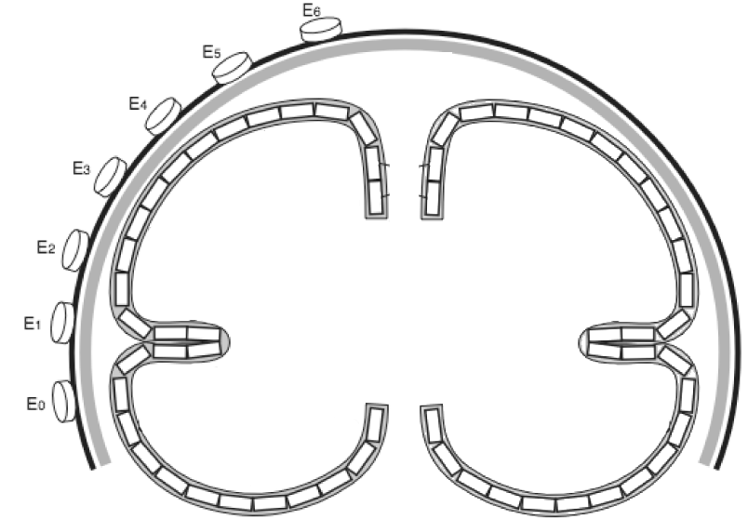
Independent Components (ICs)
1
3
3
2
2
3
1- Activity within a compact region of cortex may be independent from activity in other areas of cortex, creating an IC with a dipolar scalp distribution
2- Interconnected mirror-symmetric areas in the two hemispheres may produce one IC with mirror image dipolar scalp distributions
3- Interconnected within-hemisphere areas may produce one IC with a complex scalp distribution (or separate components may collapse into a single IC)
Notes:
© S. J. Luck. All Rights Reserved. May be used for nonprofit educational purposes if this copyright notice is included. Permission must be obtained from the copyright holder(s) for any other use.

Slide 15
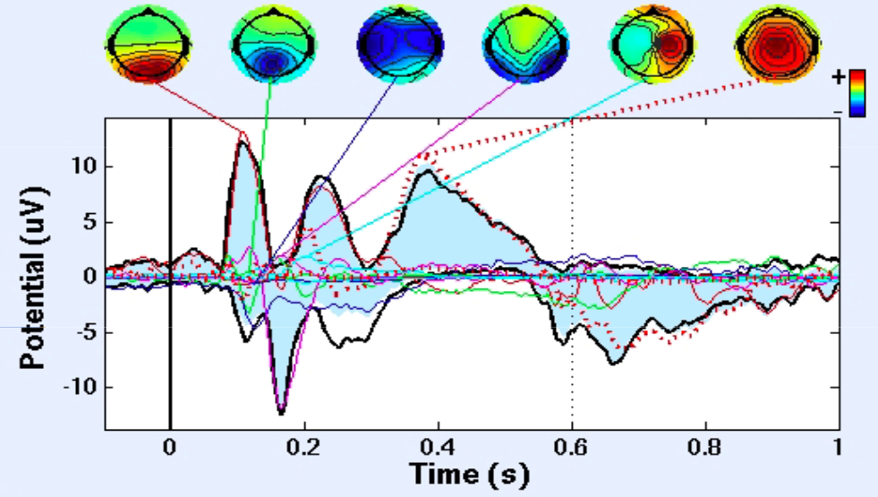
Example Components
http://sccn.ucsd.edu/
Notes:
From http://sccn.ucsd.edu/

Slide 16
Some Key Facts About ICA
Components are defined purely by statistical independence
ICA knows nothing about where the electrodes are located or even the order of time samples
Sequential dependence does not matter
Because components are learned by a neural network, they may not be exactly the same if you repeat the analysis
They will not be the same across individual subjects
# of ICs = # of channels
Typically more “true” components than channels
Multiple true components will be combined into a single IC
A single true component may be split among multiple ICs
ICA works best with strong sources, like blinks, because they are more likely to be captured by a single IC
Don’t expect ICA to isolate N2pc, ERN, etc.
Notes:
© S. J. Luck. All Rights Reserved. May be used for nonprofit educational purposes if this copyright notice is included. Permission must be obtained from the copyright holder(s) for any other use.

Slide 17
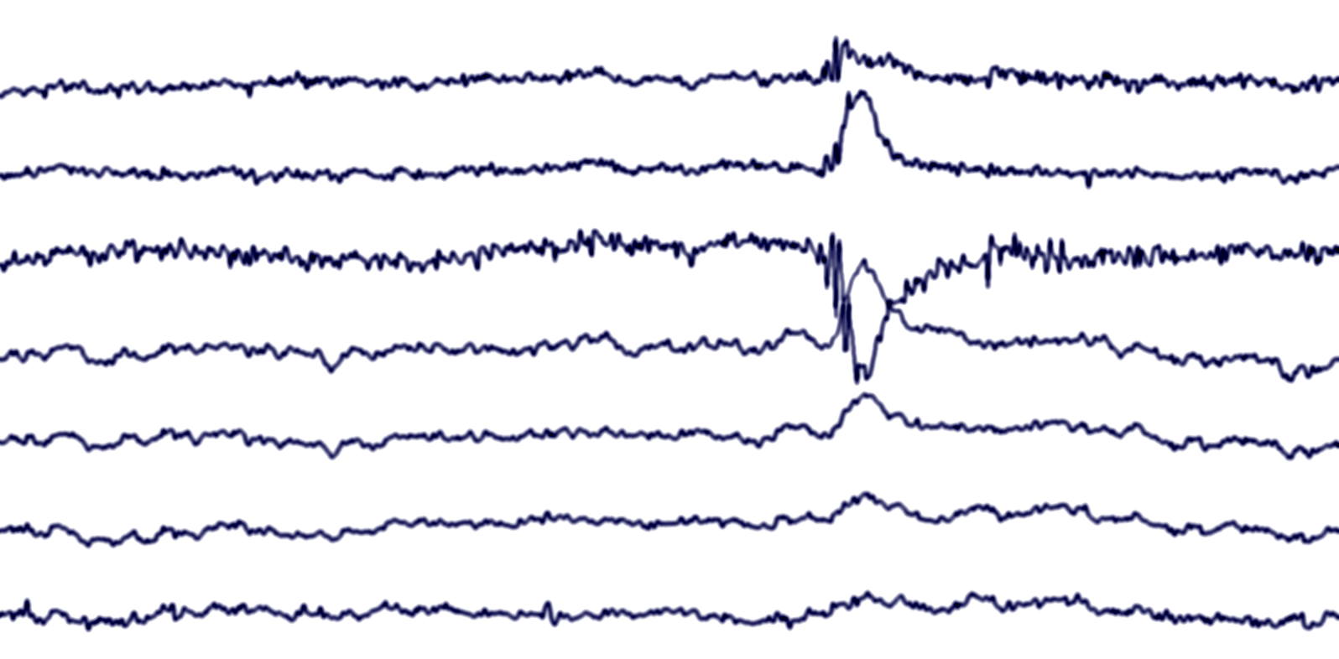
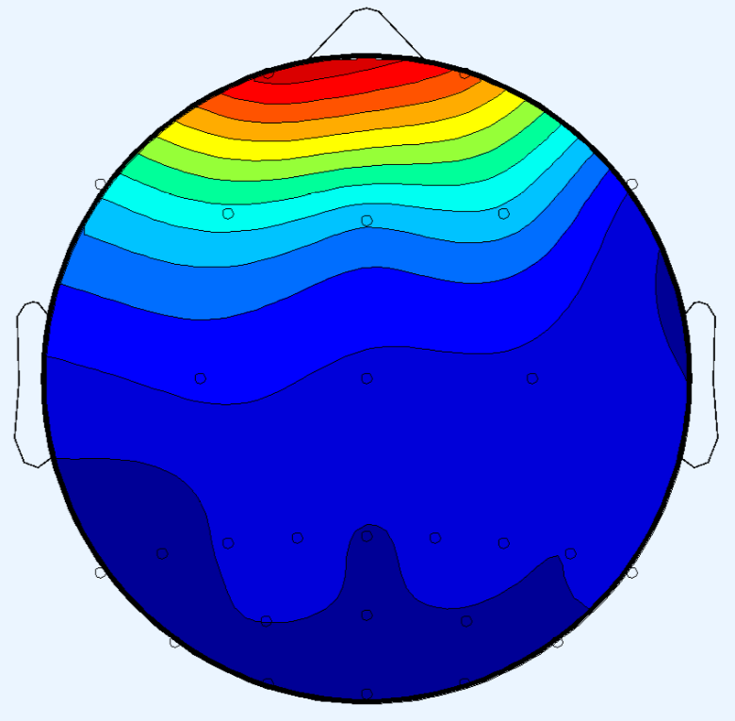
Example Blink
???
HEOG-L
HEOG-R
VEOG
Fz
Cz
Pz
Oz
Polarity inversion and gradual fall-off
Observed scalp distribution at this time
Notes:
© S. J. Luck. All Rights Reserved. May be used for nonprofit educational purposes if this copyright notice is included. Permission must be obtained from the copyright holder(s) for any other use.

Slide 18
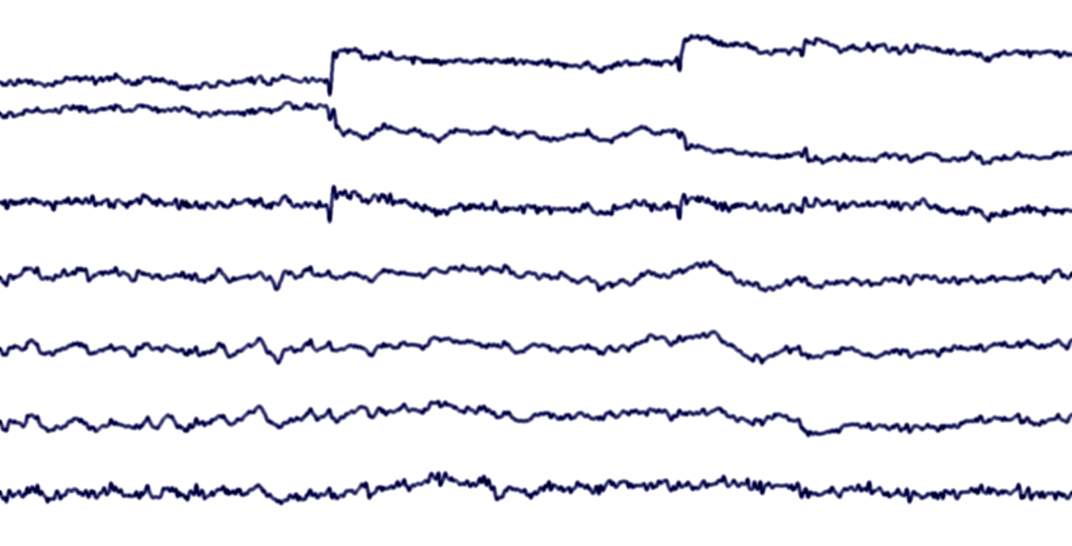
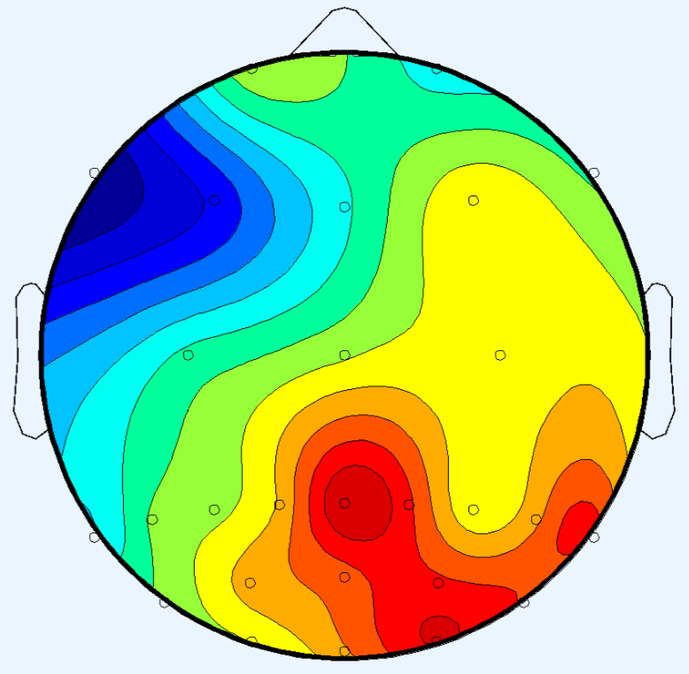
Example Horizontal Eye Movement
Leftward Saccade
Another Leftward Saccade
HEOG-L
HEOG-R
VEOG
Muscle Spike at Saccade Onset
Fz
Cz
Pz
Oz
Observed scalp distribution at this time
Notes:
© S. J. Luck. All Rights Reserved. May be used for nonprofit educational purposes if this copyright notice is included. Permission must be obtained from the copyright holder(s) for any other use.

Slide 19
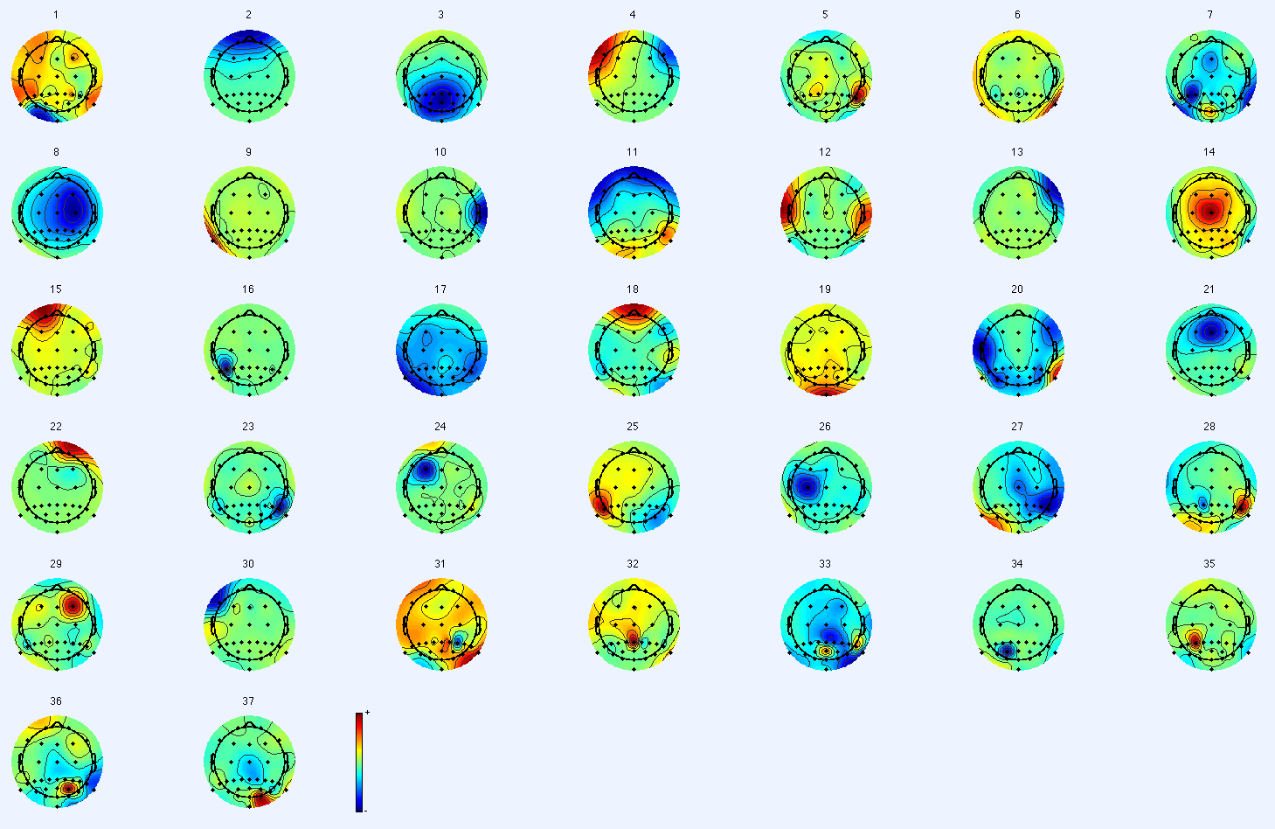
ICA Component Maps
Blink
Horizontal Eye Movement
37 Channels -> 37 ICs
Notes:
© S. J. Luck. All Rights Reserved. May be used for nonprofit educational purposes if this copyright notice is included. Permission must be obtained from the copyright holder(s) for any other use.

Slide 20
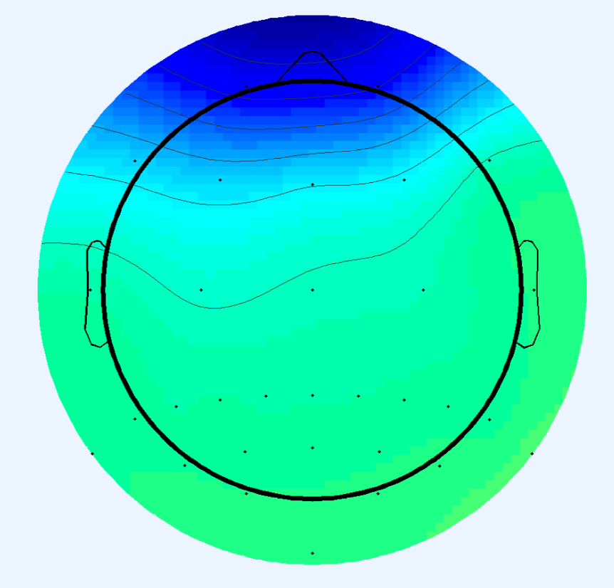
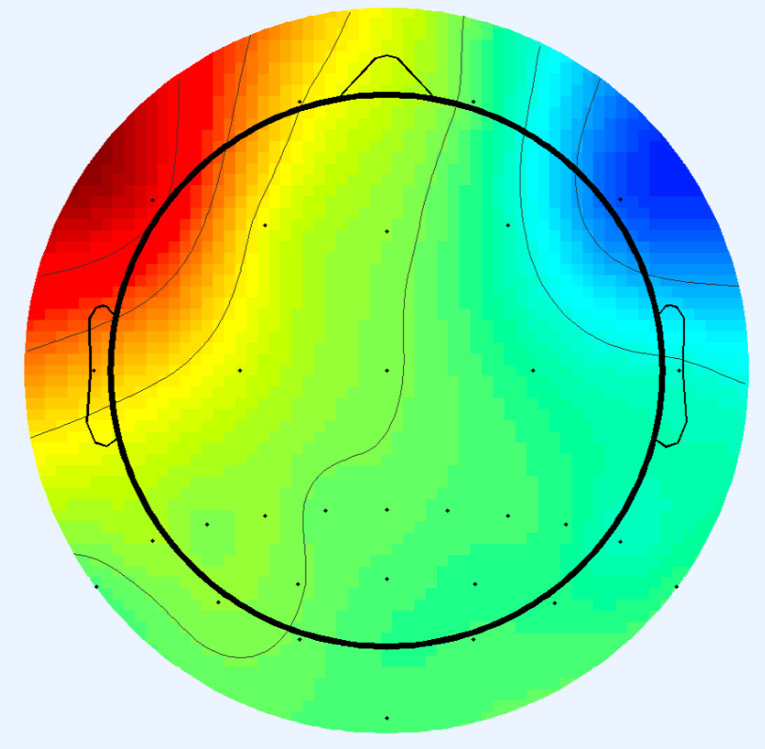
ICA Component Maps
Blink
Eye Movement
Other components are also present on any given single trial
Observed Single-Trial
Voltage Map
ICA
Component
Map
Polarity may be reversed (will reverse again in IC time course waveform)
Notes:
© S. J. Luck. All Rights Reserved. May be used for nonprofit educational purposes if this copyright notice is included. Permission must be obtained from the copyright holder(s) for any other use.

Slide 21
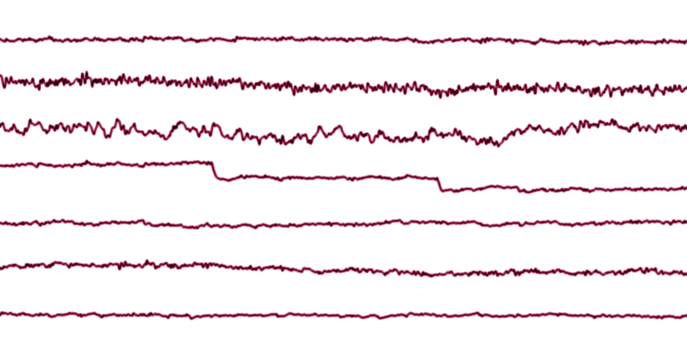
Single-Trial Time Course
HEOG-L
HEOG-R
VEOG
Fz
Cz
Pz
Time course + scalp map are used to determine which IC corresponds to each type of artifact
Oz
IC1
IC2
IC3
IC4
IC5
Magnitude and polarity of waveform depend on magnitude and polarity of scalp map
IC6
IC7
Notes:
© S. J. Luck. All Rights Reserved. May be used for nonprofit educational purposes if this copyright notice is included. Permission must be obtained from the copyright holder(s) for any other use.

Slide 22
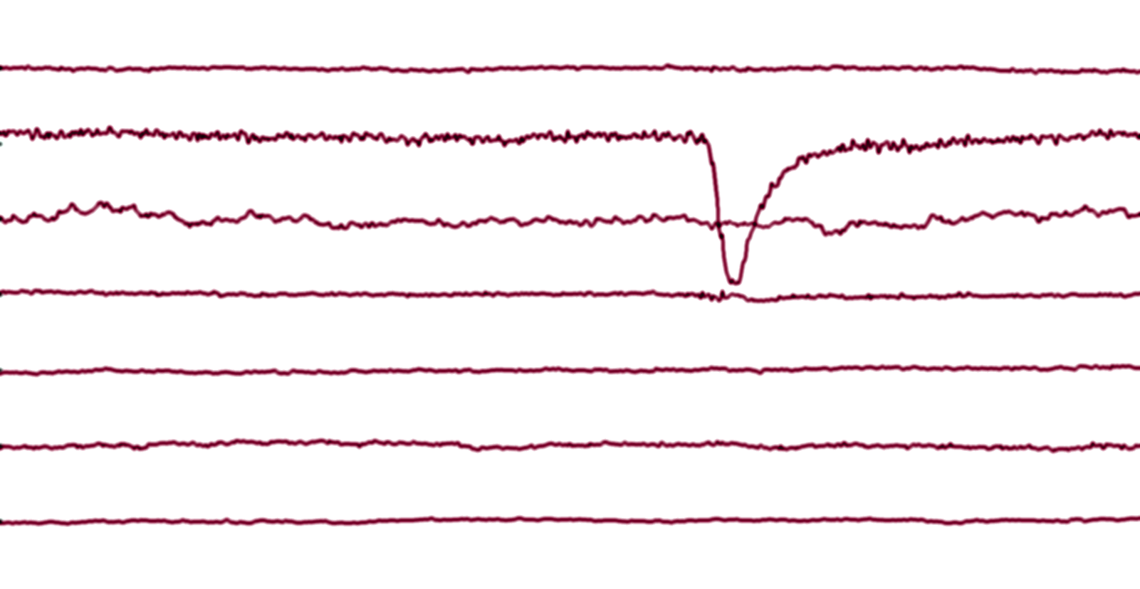
Single-Trial Time Course
HEOG-L
HEOG-R
VEOG
Fz
Cz
Pz
To remove blink in electrode j:
Set time course for IC2 to zero
Multiply the time course for each component by w_{i,j}
Sum the weighted time courses together
Repeat for each electrode
Oz
IC1
IC2
IC3
IC4
IC5
IC6
IC7
Notes:
© S. J. Luck. All Rights Reserved. May be used for nonprofit educational purposes if this copyright notice is included. Permission must be obtained from the copyright holder(s) for any other use.

Slide 23
Computing Corrected Waveforms
Component 1
Component 2
Component 3
w_{1,1}
Electrode 1
Electrode 2
Electrode 3
w_{2,1}
w_{3,1}
w_{1,2}
w_{2,2}
w_{3,2}
w_{1,2}
w_{2,2}
w_{3,2}
Could instead set weights to zero between IC2 and every electrode site
Notes:
© S. J. Luck. All Rights Reserved. May be used for nonprofit educational purposes if this copyright notice is included. Permission must be obtained from the copyright holder(s) for any other use.

Slide 24
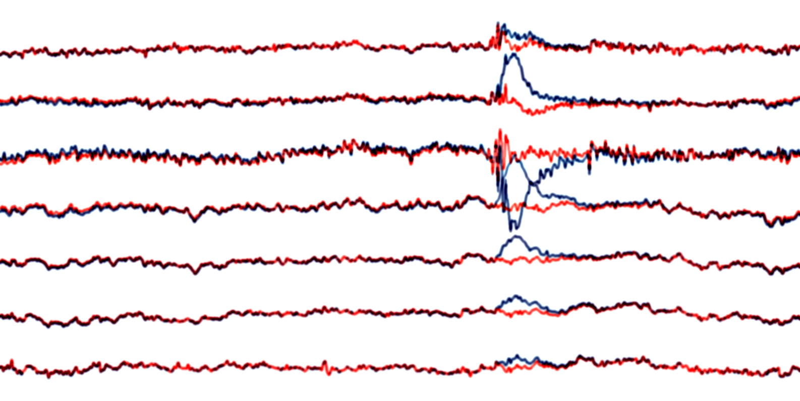
Single Trial After Correction
HEOG-L
HEOG-R
VEOG
Fz
Original
Cz
After Correction
Pz
Oz
Notes:
© S. J. Luck. All Rights Reserved. May be used for nonprofit educational purposes if this copyright notice is included. Permission must be obtained from the copyright holder(s) for any other use.

Slide 25
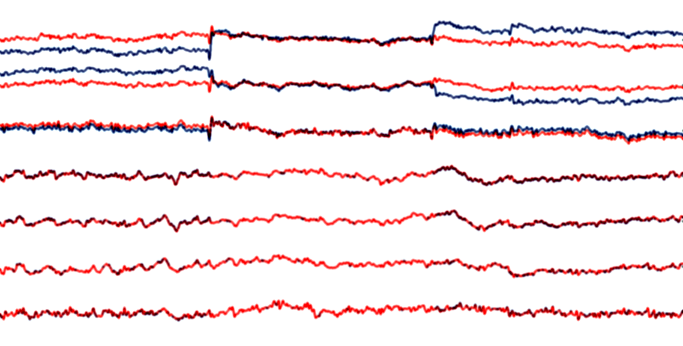
Single Trial After Correction
HEOG-L
Original
HEOG-R
After Correction
VEOG
Why is muscle spike not part of the HEOG component?
Fz
Cz
Pz
Oz
Notes:
© S. J. Luck. All Rights Reserved. May be used for nonprofit educational purposes if this copyright notice is included. Permission must be obtained from the copyright holder(s) for any other use.

Slide 26
Practical Considerations
Process of linking specific ICs with specific artifacts can be subjective and difficult
For neural network to converge on a reasonable unmixing matrix, you need to provide enough data
# samples > 20 x (# channels)²
Another reason not to record from tons of channels!
If you have N channels, you will have N ICs
Some ICs will merge multiple “real” components
Most likely to happen with relatively weak components
Implication: Hard to remove subtle artifacts
Very important to ensure that the ICs corresponding to artifacts do not collapse multiple components
Otherwise you will remove too much
Need to make sure you do not “waste” ICs on C.R.A.P.
Notes:
© S. J. Luck. All Rights Reserved. May be used for nonprofit educational purposes if this copyright notice is included. Permission must be obtained from the copyright holder(s) for any other use.

Slide 27
Eliminating C.R.A.P.
High-pass filter the data (cutoff between .01 & .1 Hz)
Use continuous EEG, not baseline-corrected epochs
Baseline correction changes relative values across channels
May work OK on epoched data with very long baselines
There is an ongoing debate about this issue
Eliminate sections of data with large C.R.A.P.
Beginning and end of each trial block
Periods of large noise (usually caused by movement)
The voltages in these data segments are huge and do not have a consistent scalp distribution
They will soak up a large number of ICs
Notes:
© S. J. Luck. All Rights Reserved. May be used for nonprofit educational purposes if this copyright notice is included. Permission must be obtained from the copyright holder(s) for any other use.

Slide 28
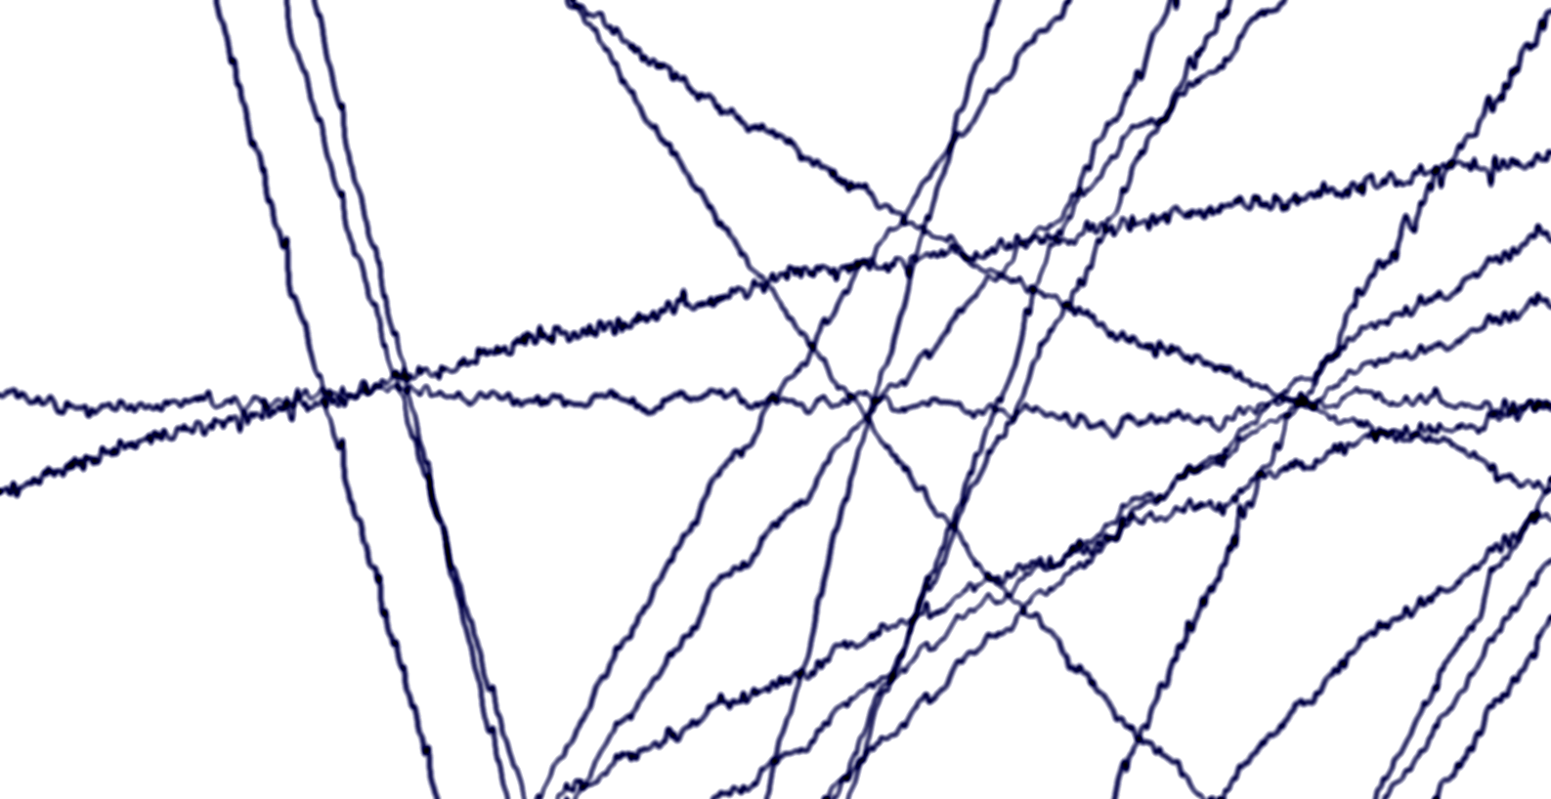
Eliminating C.R.A.P.
Beginning of Trial Block
HEOG-L
HEOG-R
VEOG
Fz
Cz
Pz
Oz
Notes:
© S. J. Luck. All Rights Reserved. May be used for nonprofit educational purposes if this copyright notice is included. Permission must be obtained from the copyright holder(s) for any other use.

Slide 29
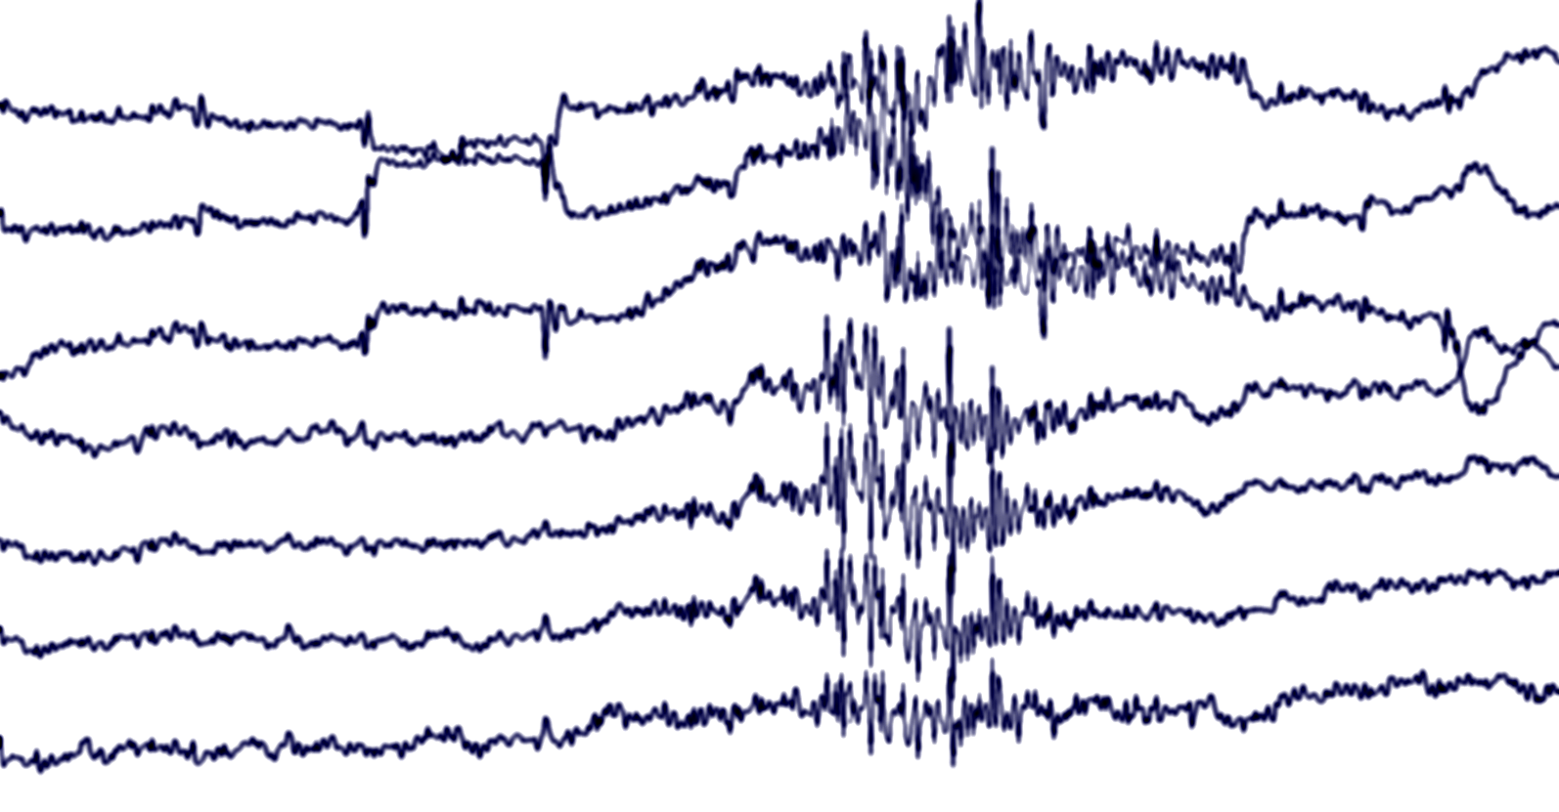
Eliminating C.R.A.P.
Noise Burst During Trial Block
(Do Not Eliminate)
HEOG-L
HEOG-R
VEOG
Fz
Cz
Pz
Oz
Notes:
© S. J. Luck. All Rights Reserved. May be used for nonprofit educational purposes if this copyright notice is included. Permission must be obtained from the copyright holder(s) for any other use.

Slide 30
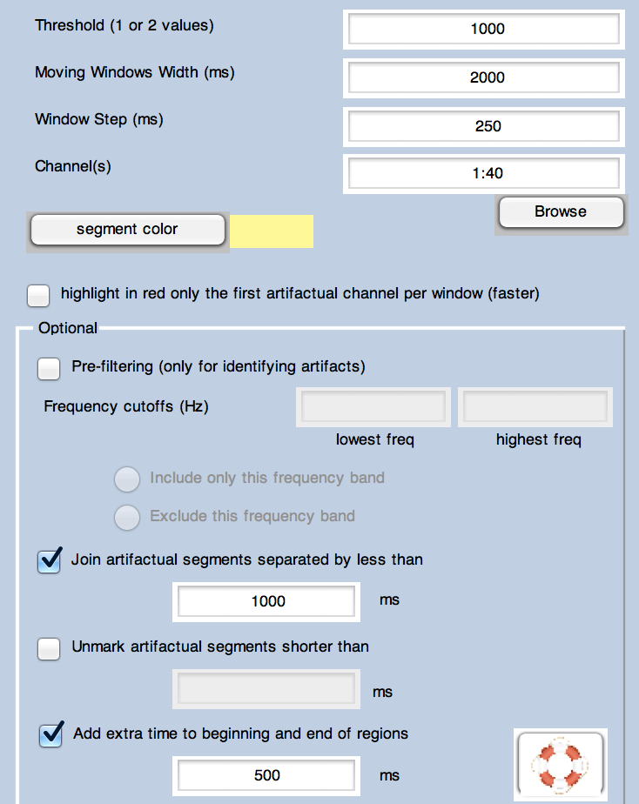
ERPLAB: Rejection from Continuous EEG
ERPLAB > Artifact detection in continuous data

Slide 31
Also…
Make sure all electrodes are linearly independent
Don’t have two versions of the same site with different references
Don’t forget to reject trials with blinks and eye movements at the time of the stimulus
ICA cannot correct for a lack of sensory input!!!
ICA seems to work very well with blinks
Should also work with EKG and line noise
ICA is much trickier with eye movements
Vertical and horizontal components have different scalp distributions but are not usually independent
Ongoing debate about EMG
Notes:
© S. J. Luck. All Rights Reserved. May be used for nonprofit educational purposes if this copyright notice is included. Permission must be obtained from the copyright holder(s) for any other use.

Slide 32
Checking Validity
Compare rejection with correction
Waveforms should be the same pattern, although noisier for rejection (because fewer trials remain in the average)
Reverse approach: Zero all ICs except for artifacts
Do artifact components differ significantly across conditions?
If so, be cautious
Test reliability of the results
Compute mixing/unmixing matrices separately for first and second halves of the experiment
Do you get the same IC scalp distributions?
In general: You are massively changing your data, so make sure you understand what you’re doing and that you check the results carefully
Notes:
© S. J. Luck. All Rights Reserved. May be used for nonprofit educational purposes if this copyright notice is included. Permission must be obtained from the copyright holder(s) for any other use.

